Slide 1



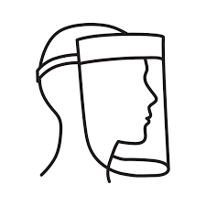

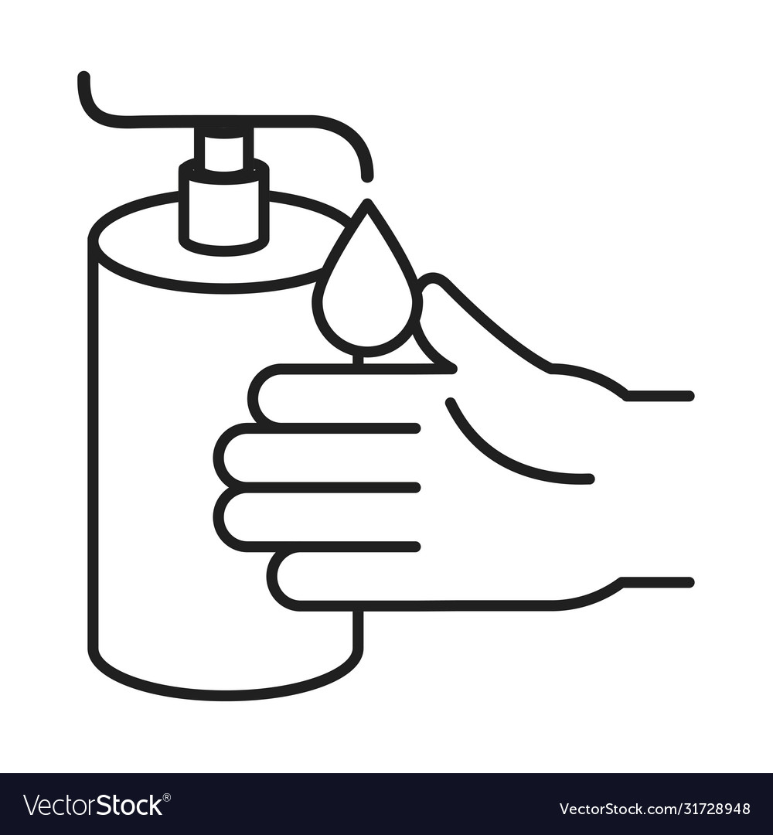
BEFORE | DURING | AFTER
Covid-19 checklist
If one ‘yes’ → no entry
(participant + researchers)
When ≥2 people in the same room:
Wear face mask
(participant + researchers)
Clean surfaces and touched items with alcohol
If not possible:
wash with water and soap
In the past 24 hours, did you experience one of more of the following (mild) symptoms: a cold, running nose, sneezing, sore throat, mild cough, shortness of breath, elevated temperature, fever and/or sudden loss of smell or taste?
Currently, does any of your housemates or family members have fever and/or shortness of breath?
Did you have covid-19 infection and has this been confirmed with a laboratory test in the past 7 days?
Do any of your housemates or family members have covid-19 (confirmed with a laboratory test) and have you been in contact with this housemate/family member in the last 14 days when he/she still had symptoms?
Are you in quarantine because you have been in direct contact with someone with covid-19 or you have returned from a region with code orange/red in the last 14 days?
When >3 minutes close contact:
Wear face shield + lab coat
Toggle the switch to clean
CLEAN
Before entering the experimental room
Disinfect hands
(participant + researchers)
Disinfect hands & air the room between two test subjects
Participant wears lab coat
When sitting in setups that are difficult to clean (e.g. vestibular chair)
DIRTY
Toggle the switch to dirty
Disinfect hands
Before and after physical contact with participant
After accidentally touching your face
After sneezing/coughing
Questions? → Contact:
Helena Cockx (0620095185, h.cockx@donders.ru.nl)
Jasper vd Heijdt (0657436323, j.vanderHeijdt@donders.ru.nl)

